Slide 1
INDUSTRY overview
Amanda Mickleburgh

Slide 2
Agenda
Fraud Industry Overview
True cost of fraud on the customer
Why do you need a fraud solution?
Types of solution
PSD2 as opportunity ( e.g. Acquirer)
Selling to Partners

Slide 3
CNP card fraud growing

Slide 4





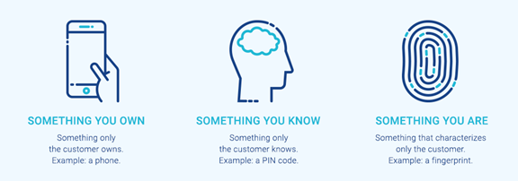
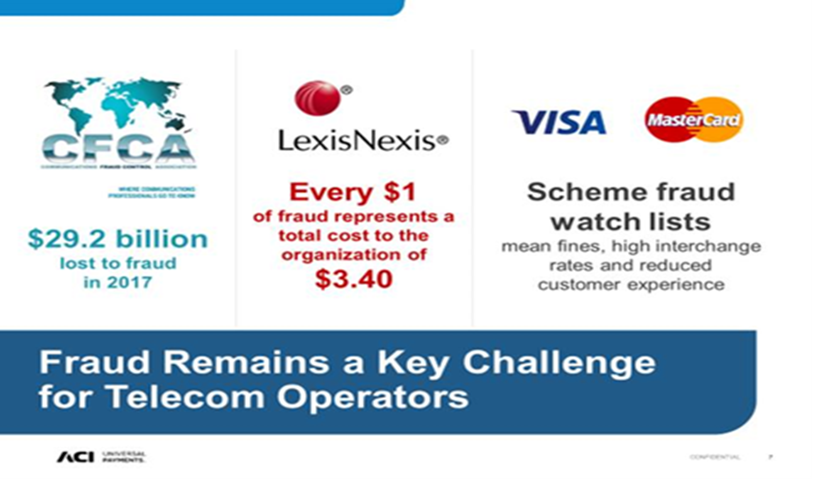


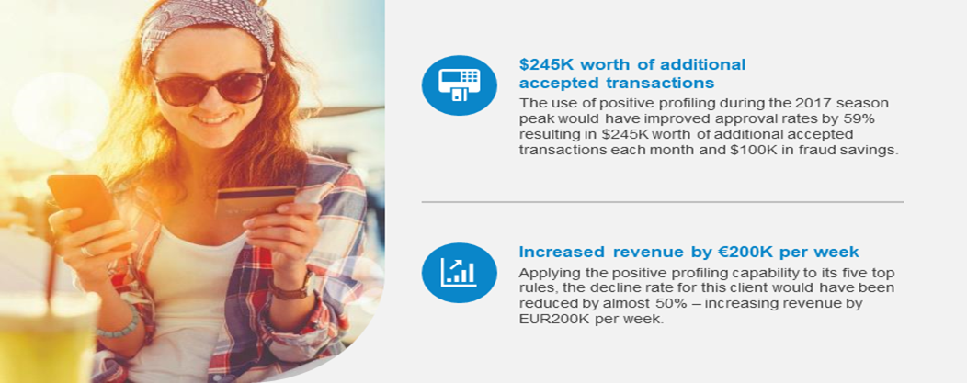


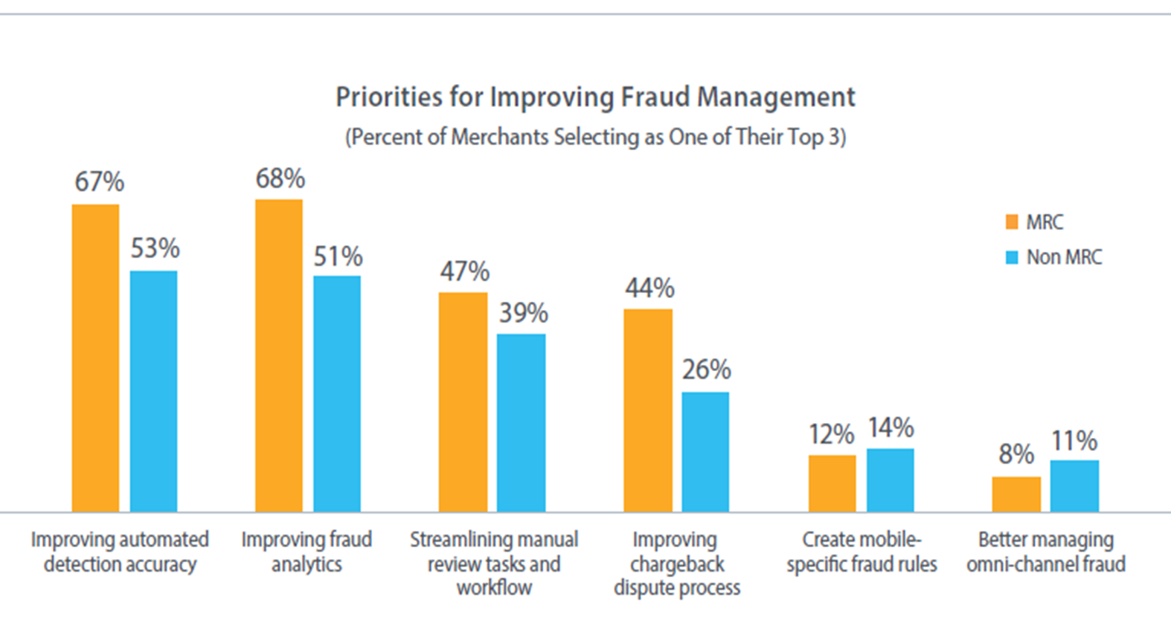




Critical to understand everything below
FEATURES
MACHINE LEARNING
RISK ANALYSTS
POSITIVE PROFILING
PSD2 SCA 3DS 2.0
CHARGEBACKS
PROJECT TITANIUM
CONSORTIUM DATA

Slide 5
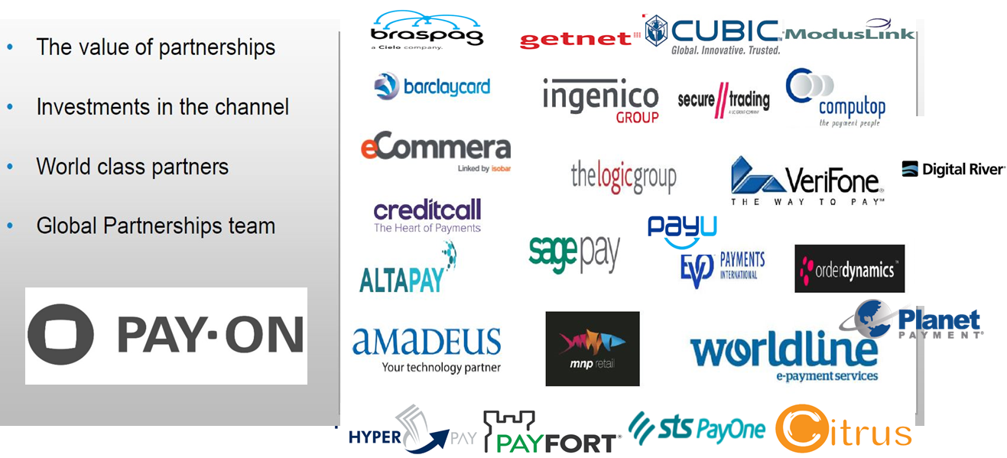
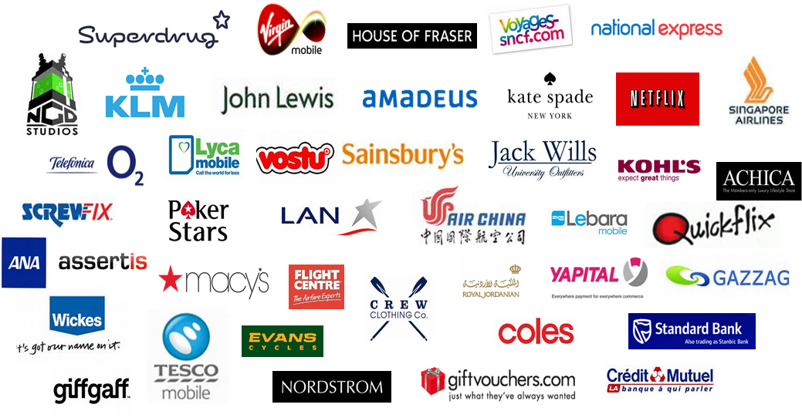
ReD Shield has a strong market presence
Integrated eCommerce and Fraud Management
Notes:
5
Great range of merchants to be proud of
Select eRetailing – Macys, John Lewis, Crew Clothing, Coles
Select Online Travel – KLM, Hotwire, Singapore Airlines, Air China
Select Digital Goods – PokerStars,
, NGD Studios, Vostu
Select Digital Services (includes Telcos) – Netflix, QuickFlix, GiffGaff, Telefonica, Lyra Mobile, Lebara Mobile Tesco

Slide 6
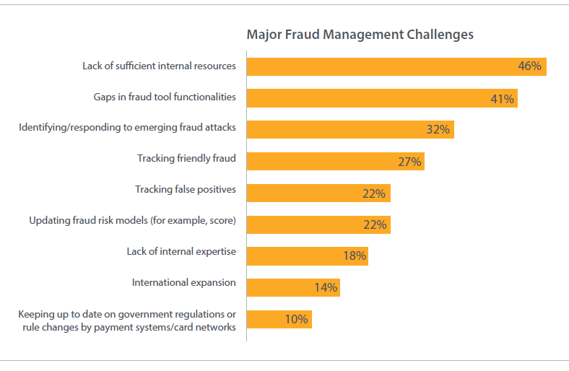
Gaps where merchants need support
Key Metrics for merchants in managing cost of fraud / payments

Slide 7

Key areas to focus on when selling fraud
Key Metrics for merchants in managing cost of fraud / payments

Slide 8
Costs that need to be managed
Cost of Manual Review Team – fraud review agents (based on % of reviews)
Cost of Sales – MARGIN impacts profitability and therefore financial impacts of chargeback
Lost revenue from Fraud declines (false positives)
Loss of customer repeat purchasing – insulting good customers impacts customer experience
Vendor Costs
Cost of actual Chargebacks
Cost of CB Fees from Acquirers
Reduction in Acquirer / Issuer Accept Rates – due to higher risk MID / Issuer risk per merchant
Customer Service costs of dealing with fraud complaints / issues
Scheme fees and fines and Acquirer bargaining power
Growth into new markets and new services / delivery
3DSecure costs (Cardinal for example)
Competition – merchants can become weakest point of compromise
Brand damage

Slide 9
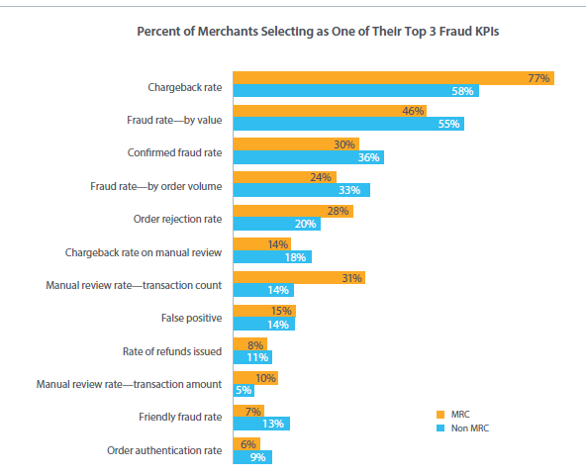
Fraud metrics tracked by merchants

Slide 10
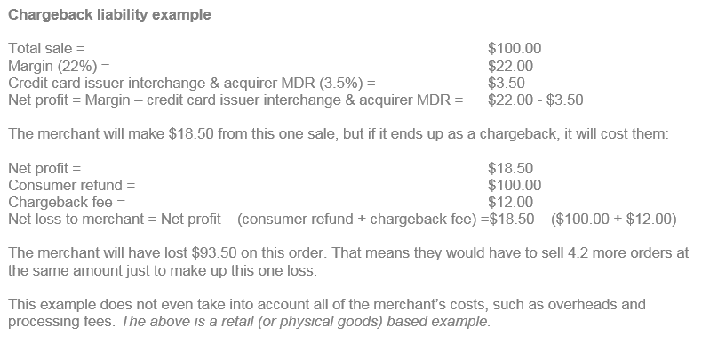
Cost of a single chargeback
Margins are important when looking at fraud – airlines for example would need to sell 50 tickets to offset the cost of a single chargeback.
- This is based on the fact that an airline makes only $50 profit on a $1,000 ticket. Opposite applies in gaming and virtual goods where margins are high (profit $8 on $10 top-up) therefor approval rates are critical

Slide 11

Cost of a chargeback - Industry

Slide 12
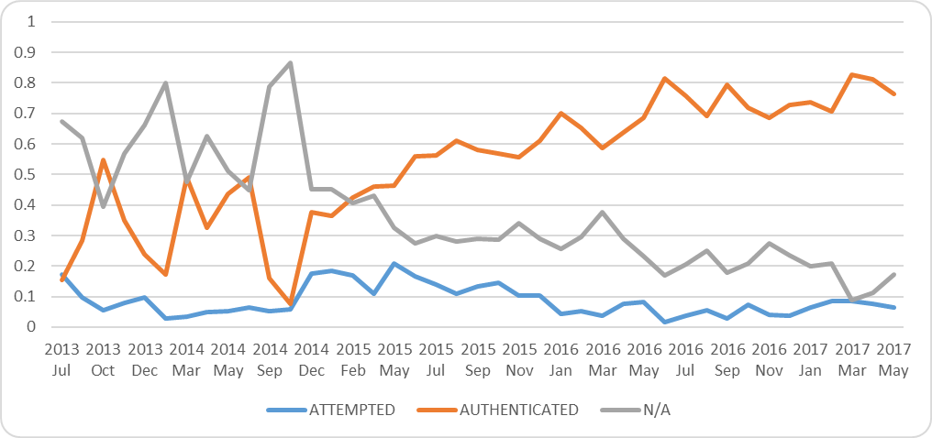
Why did 3DS fail to manage total fraud?
3DS failed, without question
Why?
If switched on, liability to issuers with no ‘real’ data (Product, Shipping, IP, Device)
If liability shifted, merchants didn’t really check as costs passed to issuers
Acquirers did nothing except make money from CB fees
Consumers disliked randomness of password requests
Created conversion issues
Issuers took the fraud = potential impact to bank approvals
Customer awareness was very poor
Will 3DS 2 .. work this time? (PSD2 / SCA)
Will improve – why?
Acquirers accountable
Issuers will get more data to define authentication
More authentication options
More communication from banks
Exemptions on low risk
Industry awareness and regulation – fines for failure
Still critical that merchants manage fraud in-house
Issuers adopt dynamic 3DS and nobody in payment flow manages fraud
– impacting bank approval rates and potential fines to merchants

Slide 13
Where do I make a fraud call?
Accept / Deny OR Accept / Challenge / Deny based on -
How products are fulfilled
Cost of manual review teams
Data captured to build rules
Actual cost of a chargeback in relation to sales / margin
Registration, In store, (not just payment check-out)
Screening:
Pre-authorisation
Ensures fraud screening of all transactions
Only passes approved transactions to the acquirer
Simpler integration
Post-authorisation
Only screens bank-approved transactions
Bank declines can be included or excluded from the rules engine (traditionally processed as ‘no score’)
Pre-Authentication
To define whether to call 3DS
To deploy exemptions in PSD2 SCA
Registration
Validating good customers to future purchase
Order Updates
If dynamics of transaction change you can re-submit to fraud decisioning
Pre Credit Check
Use profiling to define credit acceptance strategy for contracts / insurance / Telco handsets

Slide 14

















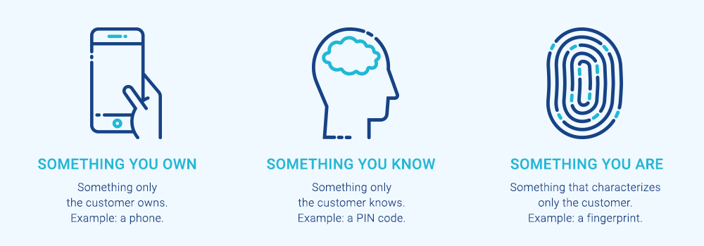

Competition – to sell fraud you need to know fraud
Previously Rules Engine domination but now new entrants offering:
Machine Learning
Indemnification
Outsourced services – reviews
Click stream analytics

Slide 15
Selling to reseller partners – Product Manager persona
Flexible and bespoke solutions to service all markets and customer types
Outsourced fraud analytics to support merchants frontline risk strategies
Full platform solution offering end to end services and products (rules, business intelligence, modelling, outsourced reviews)
Simple API integration that offer additional services in ACI gateway
Alternative payments
Additional acquirer connectors
3DS and other authentication protocols
Extensive development & investment to future proof solutions & KPI attainment
Global consortium database of fraud – in all sectors
Ability for partner to create new gateway revenue streams and services through ACI
Dedicated partner program designed to help partners market and resell fraud
Proven solutions/market leading and history of allowing partners to win more total payments business
Near real-time business intelligence and reporting platform – not just fraud rules
Reseller OR referral options
Reseller where partner bulk buys volume and owns the price to end customers on their side
Referral where partner receives a portion of ACI transaction price for facilitating business

Slide 16
Questions on Industry overview
Around the room – please name a current Red Shield customer
Around the room (5 people) – where can Red Shield perform a decision?
Around the room (5) – give me a cost to merchants on a poor fraud solution?
Around the room (5) – what GAPS do customers need to close from a fraud vendor?
Around the room (5) – why will 3DS 2.0 work better than 3DS 1.0?

